Slide 1
Continuous Probability Distribution
NORMAL DISTRIBUTION

Slide 2
Normal Distribution
The most important continuous probability distribution in the entire field of statistics is the normal distribution.
Its graph, called the normal curve, is the bell-shaped curve.
The normal distribution is often referred to as the Gaussian distribution, in honor of Karl Friedrich Gauss.

Slide 3
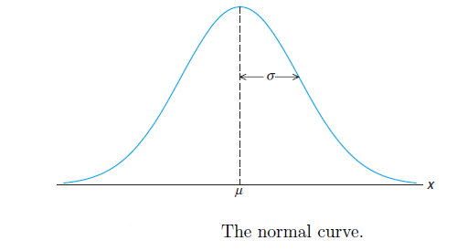
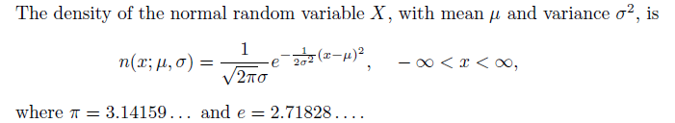
Normal Distribution
The mean and variance of n(x; μ, σ) are μ and σ², respectively. Hence, the standard deviation is σ.

Slide 4
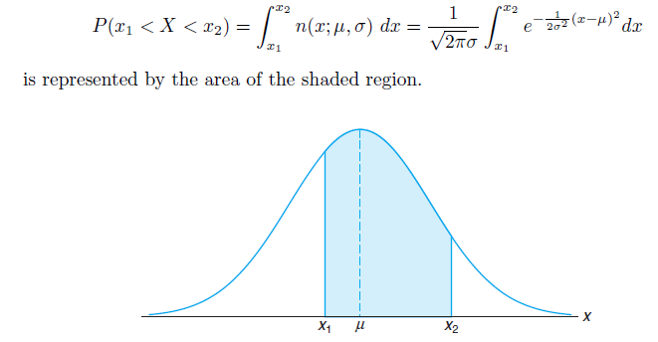
Areas under the Normal Curve

Slide 5
The difficulty encountered in solving integrals of normal density functions necessitates the tabulation of normal curve areas for quick reference.
However, it would be a hopeless task to attempt to set up separate tables for every conceivable value of μ and σ.
Fortunately, we are able to transform all the observations of any normal random variable X into a new set of observations of a normal random variable Z with mean 0 and variance 1. This can be done by means of the transformation
Z = (X − μ)/σ

Slide 6
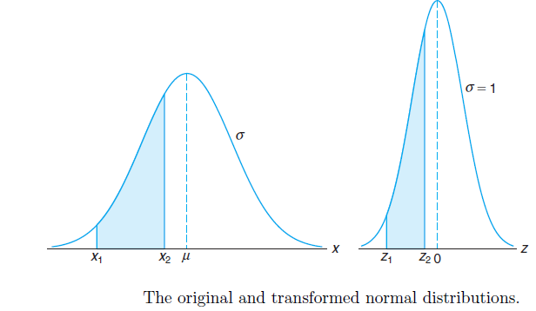
Standard Normal Distribution.
The distribution of a normal random variable with mean 0 and variance 1 is called a standard normal distribution.
Z = (X − μ)/σ

Slide 7
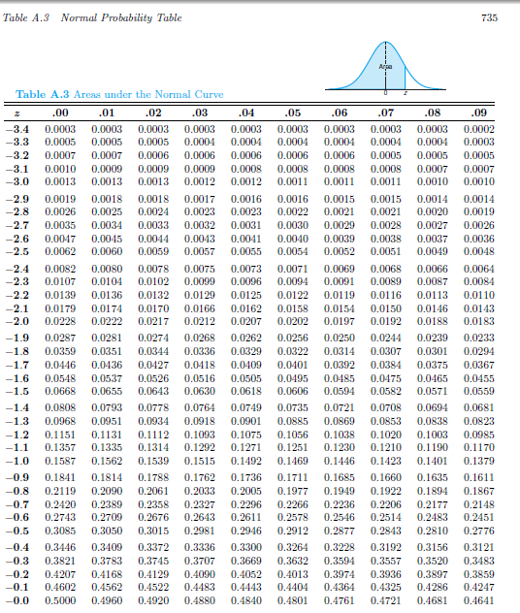

Slide 8


Slide 9
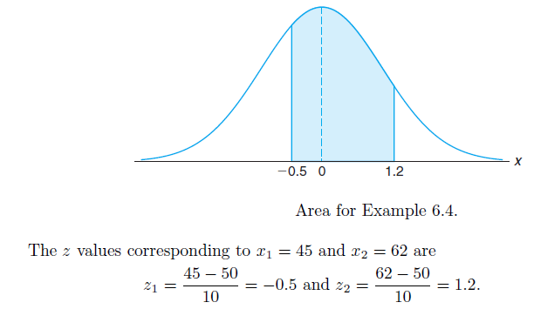


Example: Given a random variable X having a normal distribution with μ = 50 and σ = 10, find the probability that X assumes a value between 45 and 62.

Slide 10
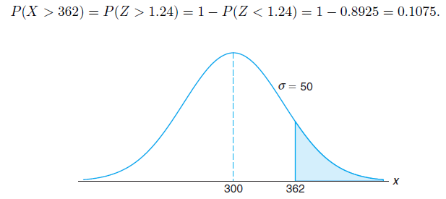
Example: Given that X has a normal distribution with
μ = 300 and σ = 50, find the probability that X assumes a value greater than 362.
Solution:
p(X>362)
z= (362-300)/50 = 1.24

Slide 11

Using the Normal Curve in Reverse

Slide 12

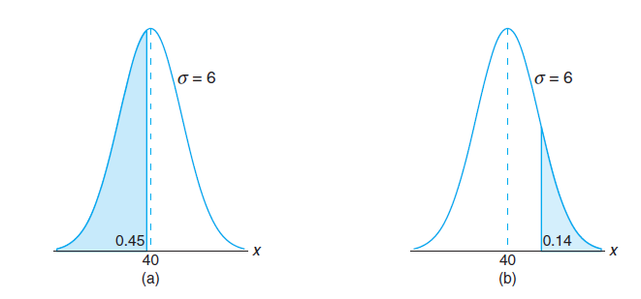
From Table A.3 we find
P(Z < −0.13) = 0.45,
so the desired z value is −0.13.
Hence,
x = (6)(−0.13) + 40 = 39.22.
From Table A.3, we find
P(Z < 1.08) = 0.86,
so the desired z value is 1.08 and
x = (6)(1.08) + 40 = 46.48.

Slide 13
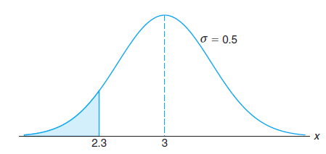
Applications of the Normal Distribution
Example: A certain type of storage battery lasts, on average, 3.0 years with a standard deviation of 0.5 year. Assuming that battery life is normally distributed, find the probability that a given battery will last less than 2.3 years.
Solution:
P(X < 2.3)
z =(2.3 − 3)/0.5 = −1.4,
and then, using Table A.3, we have
P(X <2.3) = P(Z < −1.4) = 0.0808.

Slide 14
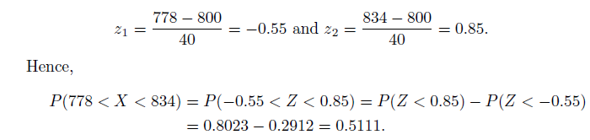
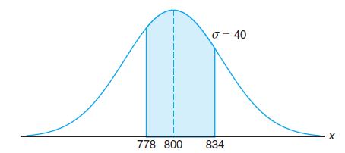
Example: An electrical firm manufactures light bulbs that have a life, before burn-out, that is normally distributed with mean equal to 800 hours and a standard deviation of 40 hours. Find the probability that a bulb burns between 778 and 834 hours.
Solution : The z values corresponding to x1 = 778 and x2 = 834 are

Slide 15

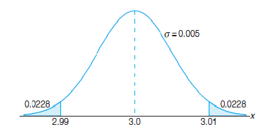
Example: In an industrial process, the diameter of a ball bearing is an important measurement. The buyer sets specifications for the diameter to be 3.0 ± 0.01 cm. The implication is that no part falling outside these specifications will be accepted. It is known that in the process the diameter of a ball bearing has a normal distribution with mean μ = 3.0 and standard deviation σ = 0.005. On average, how many manufactured ball bearings will be scrapped?
Solution :
The values corresponding to the specification limits are x1 = 2.99 and x2 = 3.01. The corresponding z values are
P(z<2.0)- P(z<-2.0) =0.9772 - 0.0228 =0.9544
=1-.9544 =0.0456.
on average, 4.56% of manufactured ball
bearings will be scrapped.

Slide 16
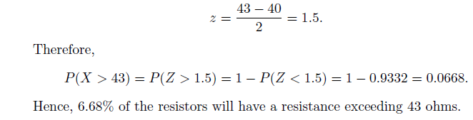
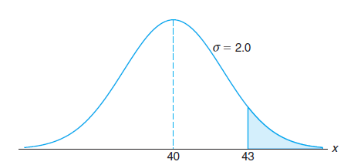
Example: A certain machine makes electrical resistors having a mean resistance of 40 ohms and a standard deviation of 2 ohms. Assuming that the resistance follows a normal distribution and can be measured to any degree of accuracy, what percentage of resistors will have a resistance exceeding 43 ohms?
Solution :

Slide 17
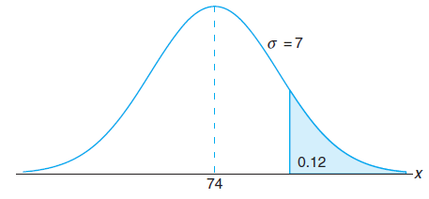
Example: The average grade for an exam is 74, and the standard deviation is 7. If 12% of the class is given As, and the grades are curved to follow a normal distribution, what is the lowest possible A and the highest possible B?
Solution :
x = σz + μ
An area of 0.12, corresponding to the fraction of students receiving A’s
We require a z value that leaves 0.12 of the area to the right and, hence, an area of 0.88 to the left.
From Table A.3, P(Z < 1.18) has the closest value to 0.88.
x = (7)(1.18) + 74 = 82.26.
Therefore, the lowest A is 83 and the highest B is 82.

Slide 18
Assignment
6.8
6.11
6.12
6.13
6.14
6.15
6.16
6.17

